Slide 1

Solving Non-linear Equation
Bisection
不正经讲师：理科宅Hunt

Slide 2
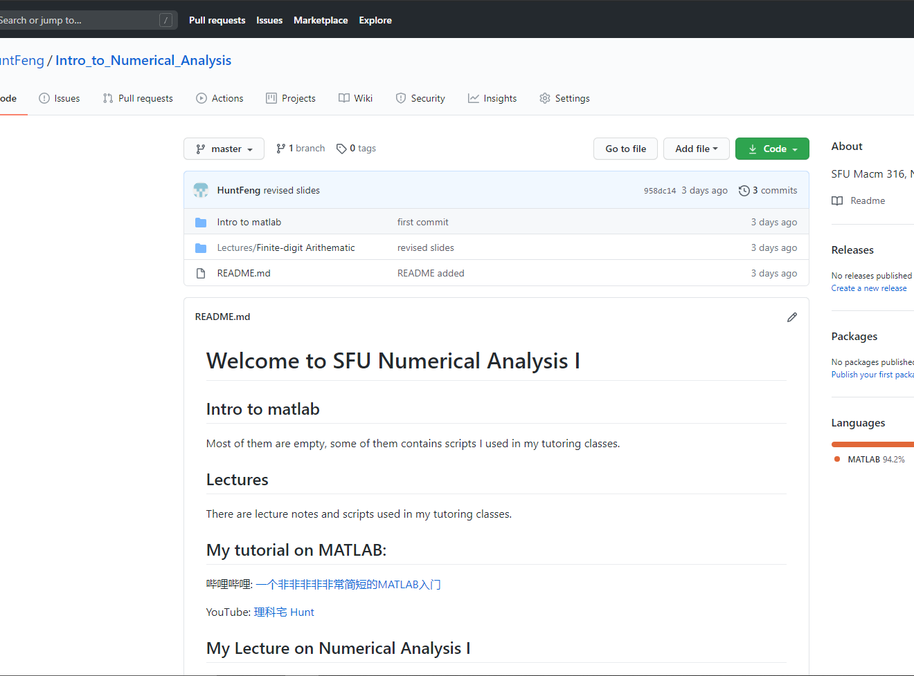
Github
https://github.com/HuntFeng/Intro_to_Numerical_Analysis

Slide 3
Bisection – 二分法
直观图像

Slide 4

Intermediate value theorem – 介值定理
Theorem: If function $f$ is continuous on a closed interval $[a,b]$, and $f\left(a\right)f\left(b\right)≤0$, then $∃c∈[a,b]$ such that $f\left(c\right)=0$.
Bisection 只能用在continuous function上
一定要保证$f\left(a\right)f\left(b\right)≤0$

Slide 5

Example
Find the approximated root of $x^{2}−2=0$ using interval [1,2].

Slide 6

Error bound – 误差范围
二分法，故名思意，每次使用都会将interval分一半，所以误差一定不会超过
$$\left|x_{n}−p\right|≤\frac{b−a}{2^{n}}$$
其中$x_{n}$是第n次近似值，$p是方程$的根.

Slide 7

Example
Find the approximated root within the tolerance ${10}^{−1}$ of $x^{2}−2=0$ using interval [1,2].

Slide 8
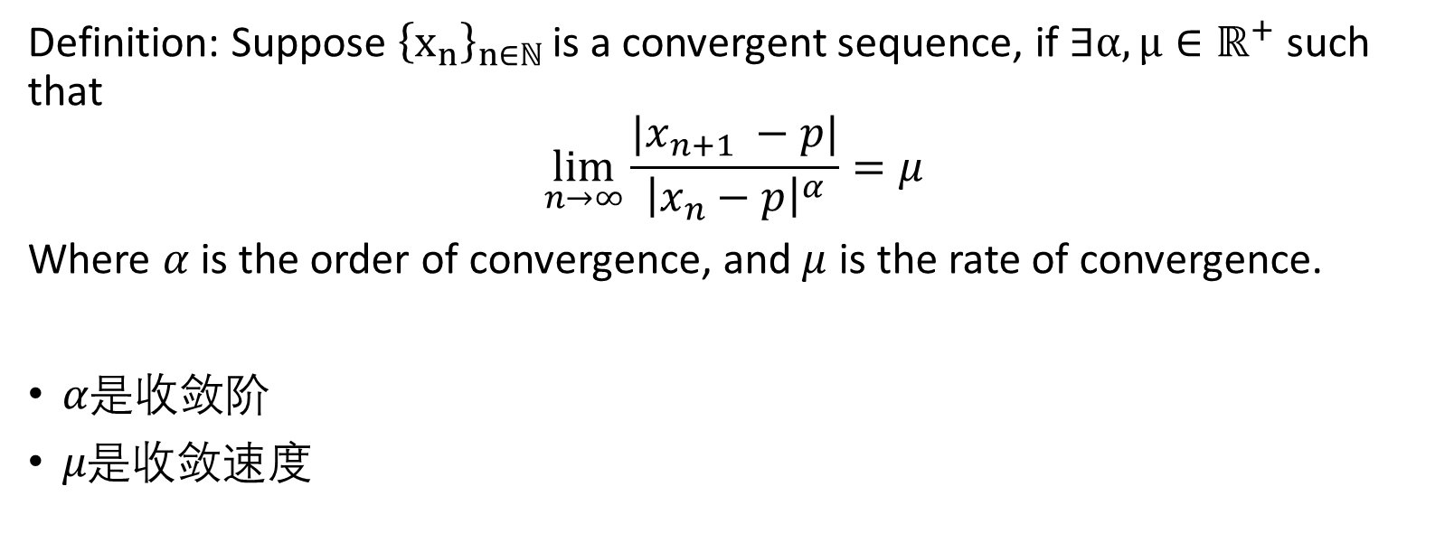
Order/Rate of Convergence – 收敛阶/速度
Definition: Suppose ${\left\{x_{n}\right\}}_{n∈ℕ }$is a convergent sequence, if $∃α,μ∈ℝ^{+}$ such that
$$\lim_{n→∞}\frac{|x_{n+1} −p|}{{\left|x_{n}−p\right|}^{α}}=μ$$
Where $α$ is the order of convergence, and $μ$ is the rate of convergence.
$α是$收敛阶
$μ是$收敛速度

Slide 9
Order of convergence - Bisection
Theorem: The order of convergence of bisection is 1. In other words, bisection method is linear convergent.

Slide 10
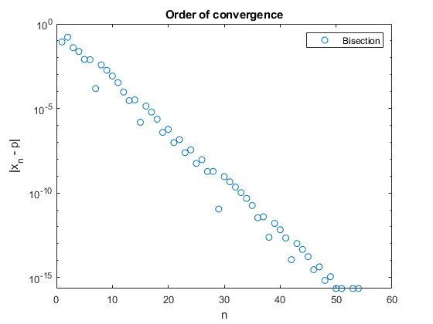
Order of convergence - Plotting
在semilogy的scale下，err-n图是一条直线
又或者说， Linear convergence就是log err – n图是一条直线

Slide 11

Conclusion
二分法的算法就是一半一半地分区间
二分法只能用于continuous function，$f\left(a\right)f\left(b\right)≤0$ 的情况
二分法的error bound是 $\left|x_{n}−p\right|≤\frac{b−a}{2^{n}}$
二分法的order of convergence 是 1 (或者说linear)

